Slide 1
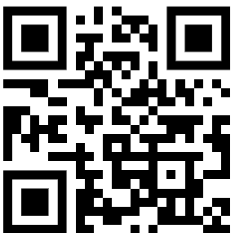
DeepDive Mastering Agents, MCP & Other Hypes
Dr. Damir Dobric
Lead Software Architect daenet GmbH / ACP Digital
Microsoft Regional Director,
Most Valuable Professional: AI

Slide 2
AGENDA
Models and Text generation
Microsoft Agent Framework
RAG
Functions & Tools
MCP
Build your custom CLAW

Slide 3
COMPLETIONS

Slide 4
Completing Text Under the hub
C# Application
Using OpenAI nuget package
Executing ChatCompletions
Presenting Probabilities
.\src\OpenAI.Samples Sample: ChatCompletionsAsync

Slide 5
AGENTS Microsoft Agent Framework

Slide 6
MAF Important Topics
Single Agent and Service Connectors
Middleware Hooks
Agent Memory and Context Providers
Agent Workflows
Multi-Agent Orchestration
Declarative Agents and Workflows (YAML)
A2A, and MCP
Migration Assistants (Semantic Kernel and AutoGen)

Slide 7
MAF Demos
Simple Agent
Session and Multiturn
src\Agents\AgentFrameworkSamples 1_HelloAgents RunAsync {Run with and without stream} RunMultiturnAsync

Slide 8
Retrieval Augmented Generation R A G

Slide 9
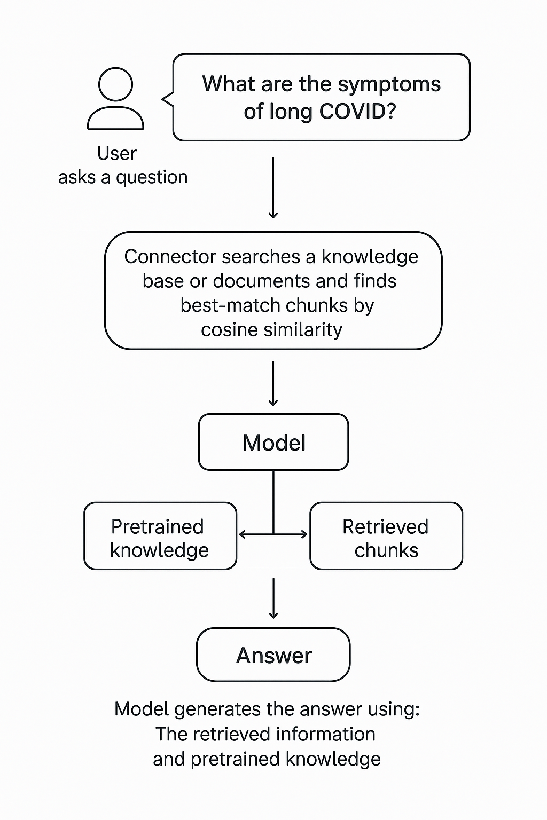
What is RAG?
Extending the model knowledge
Combines information retrieval with text generation
https://arxiv.org/abs/2005.11401

Slide 10
Reranking
The Problem: Embedding similarity ≠ meaning
The Solution = Reranking = a second, smarter filtering step
After retrieval:
You take the top k candidates (e.g., 20 chunks)
You pass them—together with the query—into a reranker model
The model scores each chunk based on actual relevance to the query
You keep the best n (e.g., top 3–5)

Slide 11
RAG Demo
Creating chunks
Creating embeddings
InMemory Vector DB
Agent with context
.\src\Agents\RagAgent .\src\SKTrainingSolution\semantickernelsample\ Samples: RagSample.cs

Slide 12
AGENTS Microsoft Agent Framework

Slide 13

User -> Model Chat iteraction
User: How are you?
(1)
AI
Prompt
(2)
Assistent: I‘m fine, how can I help you

Slide 14
Function Calling Specification
{
"type": "function",
"function": {
"name": "get_weather",
"description": "Retrieves current weather for the given location.",
"strict": true,
"parameters": {
"type": "object",
"properties": {
"location": {
"type": "string",
"description": "City and country e.g. Bogotá, Colombia"
},
"units": {
"type": ["string", "null"],
"enum": ["celsius", "fahrenheit"],
"description": "Units the temperature will be returned in."
}
},
"required": ["location", "units"],
"additionalProperties": false
}
}
}

Slide 15
Function Calling
User: Switch on the light to green.
LichtPlugin
SwitchLightOn(color)
SwitychLightOff
(1)
WeatherPlugin
ShowInfo(Location)
AI
Prompt
(2)
SqlQueryPlugin
Tool: SwitchLightOn(green)

Slide 16
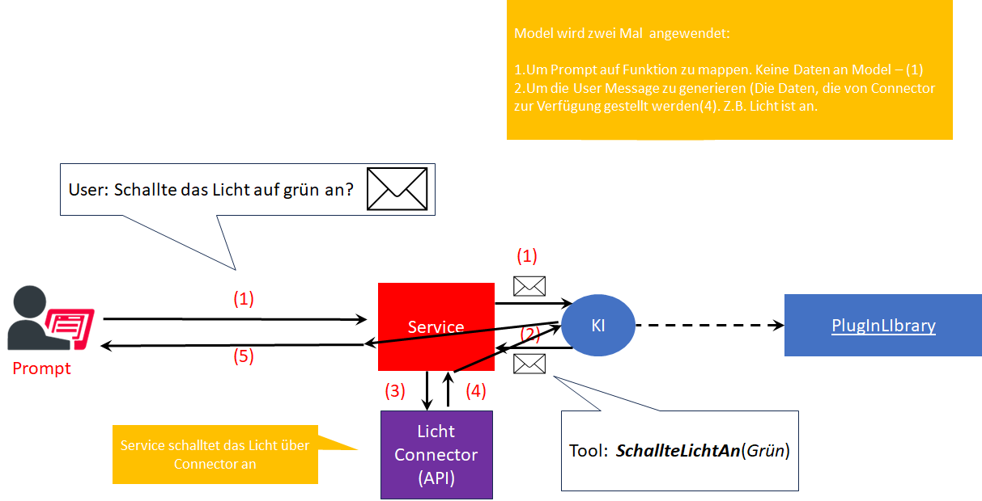
Function Calling

Slide 17
Agents with Functions/Tools
Tools (Functions, Plugins)
src\Agents\AgentFrameworkSamples 1_HelloAgents RunWithToolsAsync

Slide 18
MCP Model Context Protocol

Slide 19
MCP
Created by Anthropic Adopted by the AI community
Specification - Model Context Protocol

Slide 20
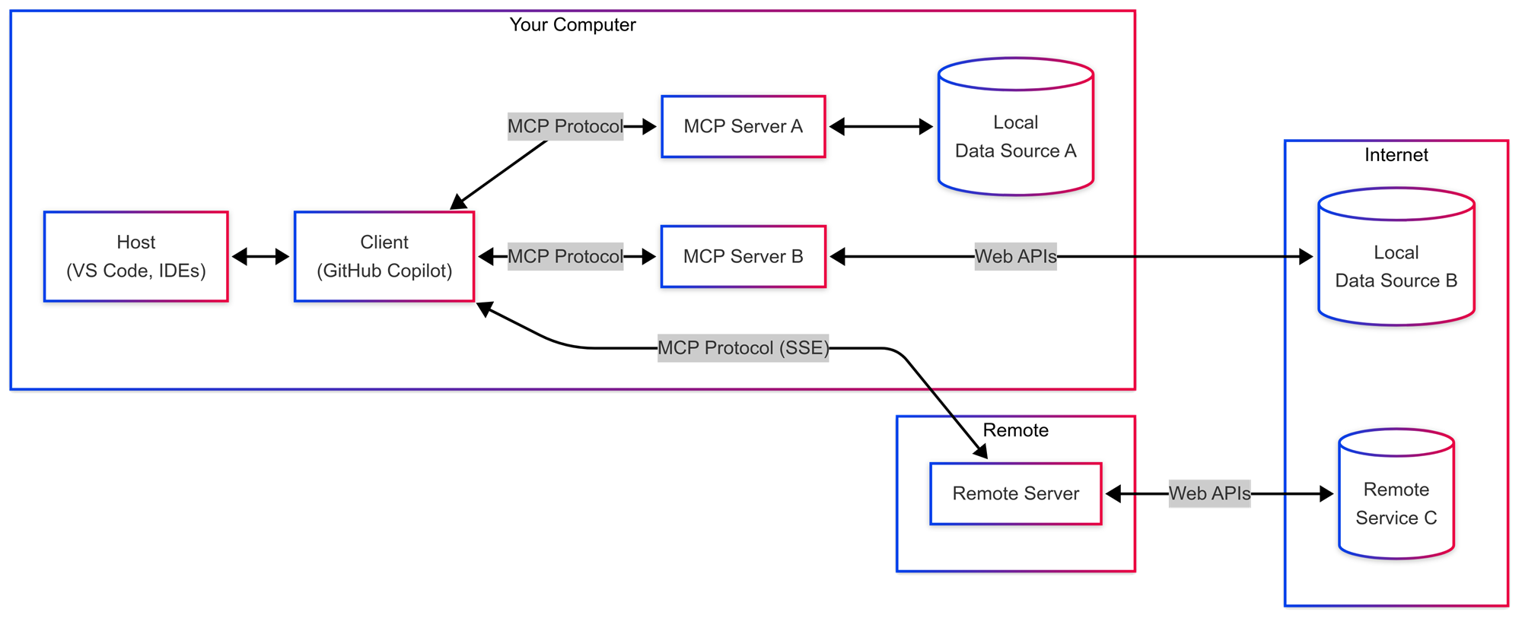
Why MCP and how does it work?
stdio
stdio
Application/Agent
http stream

Slide 21
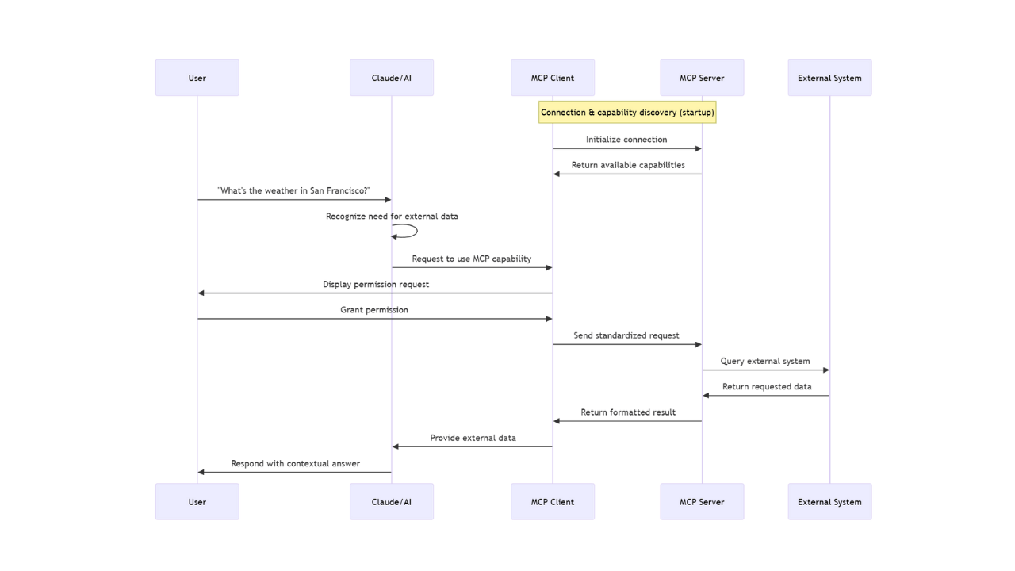
MCP under the HUB

Slide 22
MCP Demos
Agent using STDIO MCP
Agent using HTPP MCP
.\src\Agents\AgentFrameworkSamples\MCP

Slide 23
Building your own CLAW

Slide 24
THANK YOU ☺
Dr. Damir Dobric
Lead Software Architect daenet GmbH / ACP Digital
Microsoft Regional Director,
Most Valuable Professional: AI

